Slide 1
Thank you for downloading!!
Hope it helps you with your presentations!
In case the fonts don’t work, try installing these onto your computer!
Titillium Web: https://fonts.google.com/specimen/Titillium+Web
Jura: https://fonts.google.com/specimen/Jura
Montserrat: https://fonts.google.com/specimen/Montserrat
@dstoryco

Slide 2


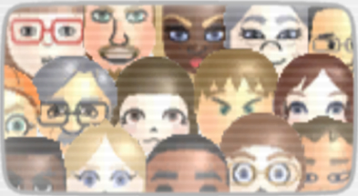
Fri 25/04

Slide 3
Presenters
Back
Next

Slide 4
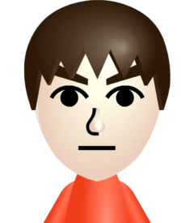
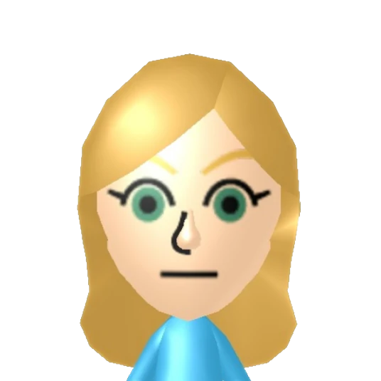
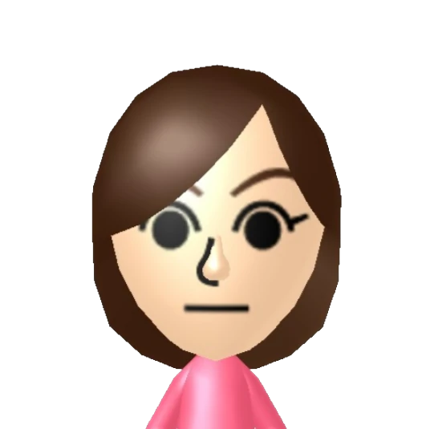
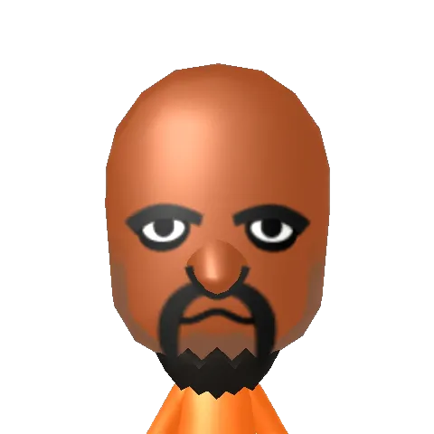

D Story
Ola
Faith
Matt

Slide 5
Fri 25/04

Slide 6
Why Wii is Best
Back
Next

Slide 7

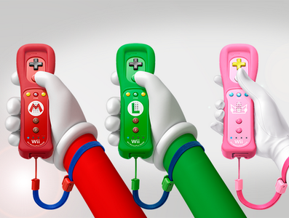
Why Wii is Best
Innovative Gameplay
Revolutionary Controller
Accessible to Everyone
Diverse Game Library
Affordable & Durable

Slide 8
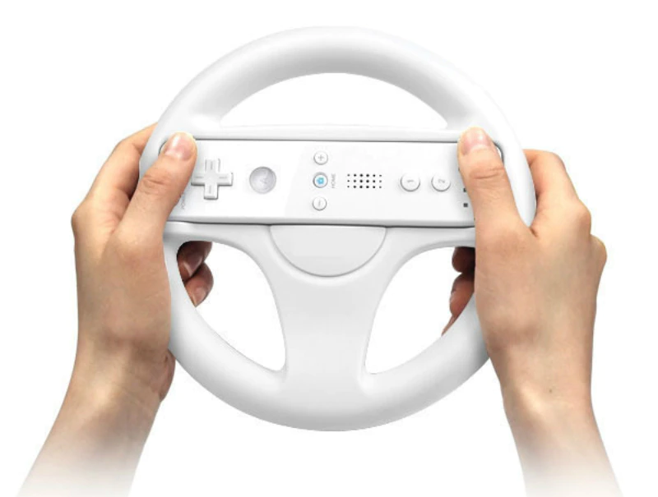
Why Wii is Best
Innovative Gameplay
Revolutionary Controller
Accessible to Everyone
Diverse Game Library
Affordable & Durable

Slide 9
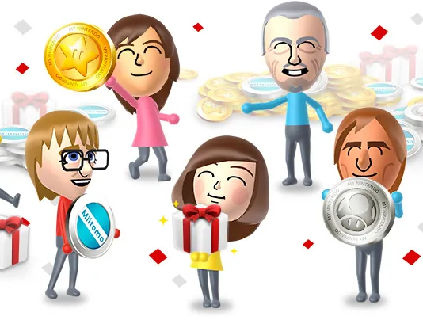
Why Wii is Best
Innovative Gameplay
Revolutionary Controller
Accessible to Everyone
Diverse Game Library
Affordable & Durable

Slide 10
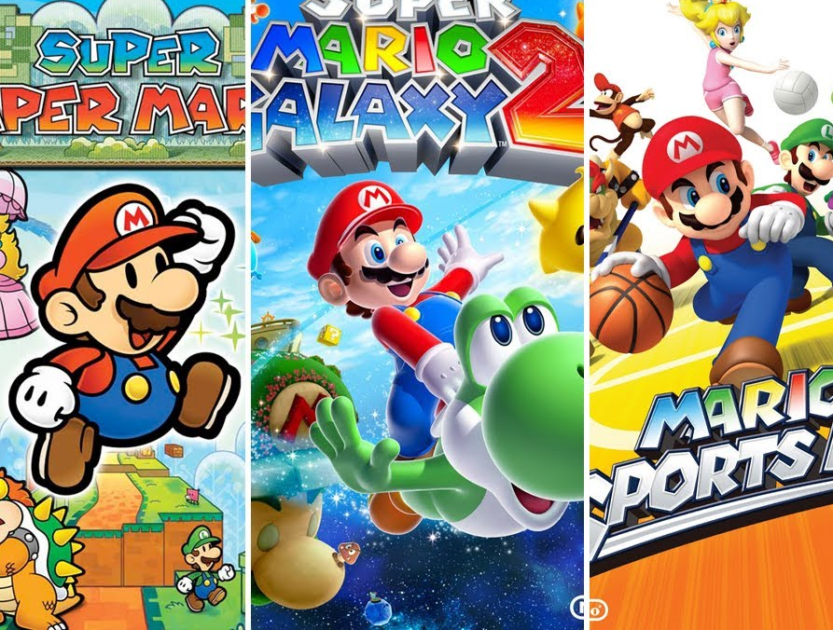
Why Wii is Best
Innovative Gameplay
Revolutionary Controller
Accessible to Everyone
Diverse Game Library
Affordable & Durable

Slide 11
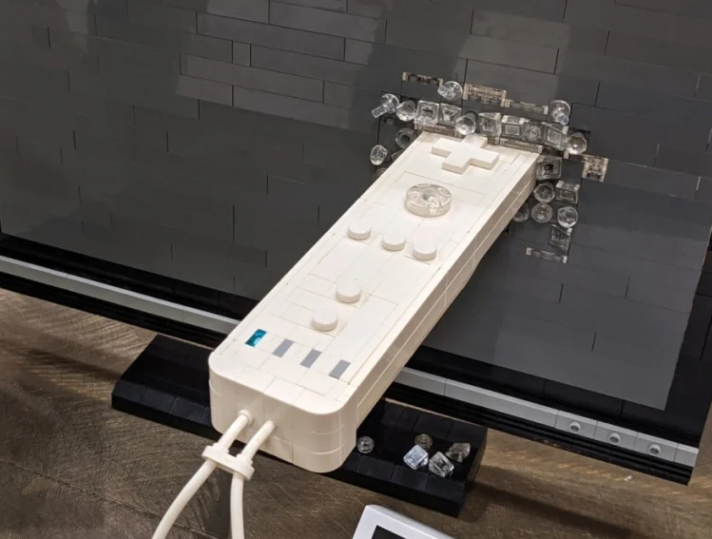
Why Wii is Best
Innovative Gameplay
Revolutionary Controller
Accessible to Everyone
Diverse Game Library
Affordable & Durable

Slide 12
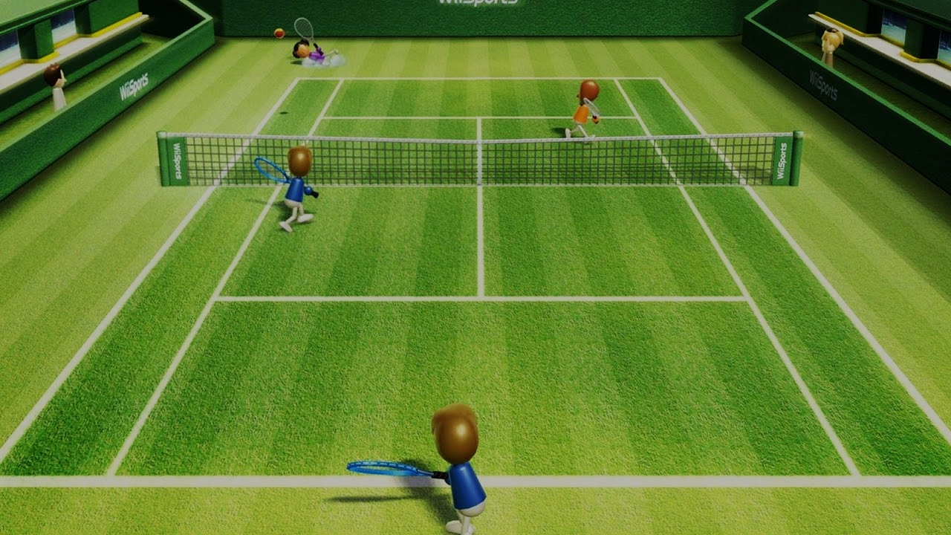




Console Sales
Play again
Quit

Slide 13

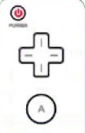
HOME Menu
Close
Wii Menu
Q&A
P1
P2
P3
P4
Thank you for watching!

